Slide 1
Bank Model
Bank Team One
Analytics and Model
September 25 2015
Notes:
Template version: 7/29/2013, for PowerPoint 2010

Slide 2
{Model Objective}
Build a model to classify customers who respond and convert to Term Deposit Campaign
What are useful characteristic to run a successful campaign?
Hypothesis Driven Analysis, key factors to convert:
Identify Impact of Seasonality
Co-Relation between Profession, Age and Cash availability, Liabilities, Frequency of contact, day of the month
Explore key factors to get better conversion rate:
Cash at hand
Identify Optimal Timing for reachin g to customers - Reach to them early in the month
No Liabilities, No Defaults
Tax return season
Success of previous campaign
Frequency of contacts
Number of contacts

Slide 3
{Data Analysis}
Data Exploration
Numerical variables – Correllograms
Categorical variables - Distribution
Imbalanced Target
Undersampling to balance the target
Re-run the model fit

Slide 4
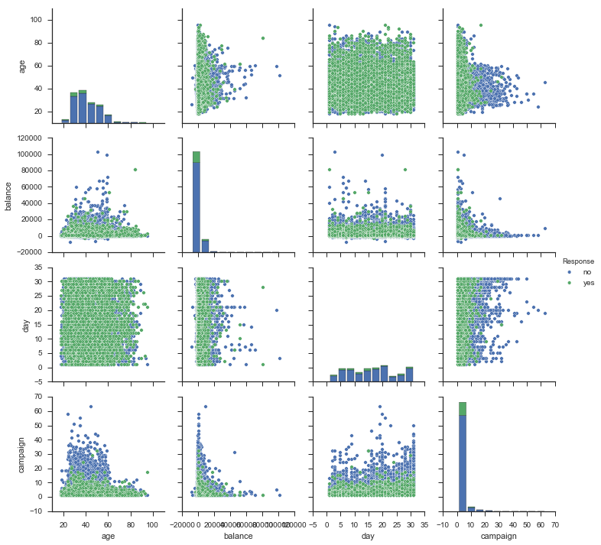
{Data Analysis}

Slide 5
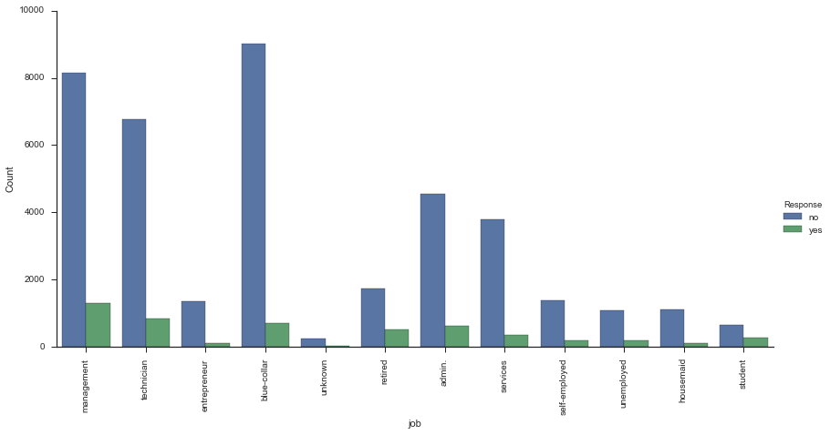
{Data Analysis}

Slide 6
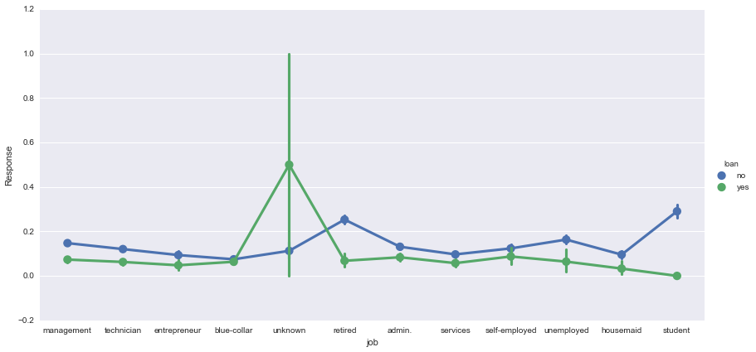
{Feature Selection}
Response Rates by Interaction terms of Categorical Variables

Slide 7
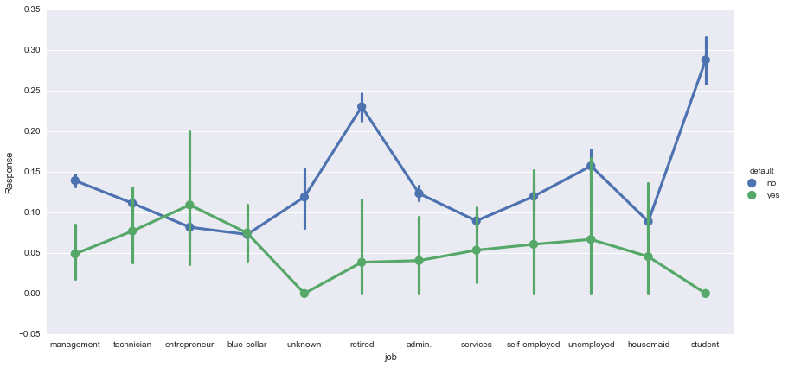
{Feature Selection}

Slide 8
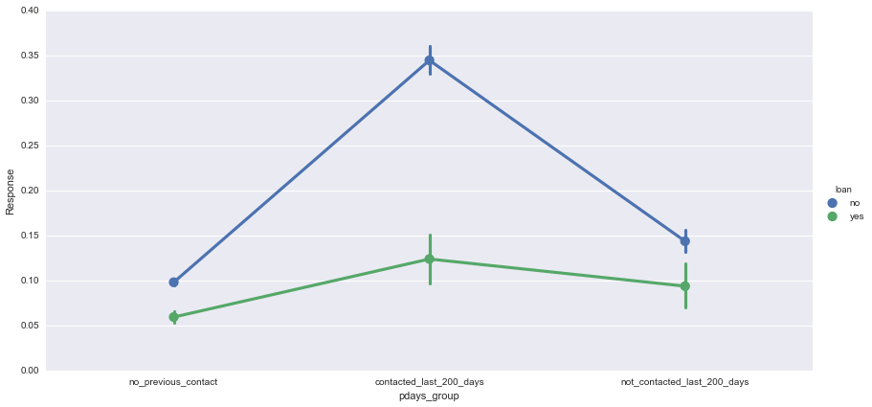
{Feature Selection}

Slide 9
{Feature Selection}
Throw Imbalanced and Balanced data with all dummy variables to Random Forest for feature importance
Fit a logistic regression, KNN, Decision Trees with balanced data
Logistic Regression was finally selected for interpretability

Slide 10
{Feature Selection}
Variable Name | Coefficient | Possible Drivers?
success | 2.102 | Prior Success, Data Issue - Unknowns need to be captured
mar | 1.704 | Tax Returns?
oct | 1.682 | Holiday Promotions?
cellular | 0.897
dec | 0.790 | Holiday Promotions?
gt_2500_balance | 0.5279 | Disposable Cash, split deposit balances
Housing_no | 0.4494 | Cash on hand, no liabilities
student_default_no | 0.4233 | Student Promotion?
student_loan_no | 0.4234 | Student Promotion?
middle to late of month | -0.4227 | Paychecks have ran out/ Other Bills
retired_housing_no | 0.4168 | Cash on hand, no liabilities
Loan_no | 0.3661 | Cash on hand, no liabilities
contacted_last_200_days_loan_no | 0.3047 | Frequent Contact with the customer
1_contact_campaign | 0.2786 | Multiple opportunities to explain product to customer
end of month_pdays_group_no_previous_contact | -0.2497 | Lack of Cash, lack of prior customer touchpoints?
Default_yes | -0.2101 | No cash available for deposits
le_2500_balance | 0.20174 | While low balance has positive coefficient, it’s several time smaller than >$2500
tertiary | 0.1779 | Highly Educated, well employed?
not_contacted_last_200_days_loan_no | 0.0278 | No liabilities?

Slide 11
{Model Outcome}
Logistic Regression Model Score: 0.72
Accuracy Score: 0.72
Classification Report:
Target | precision | recall | f1-score | support
no | 0.71 | 0.89 | 0.79 | 2455
yes | 0.76 | 0.48 | 0.59 | 1766

Slide 12
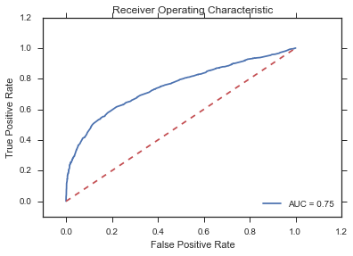
{Model Outcome}

